Slide 1
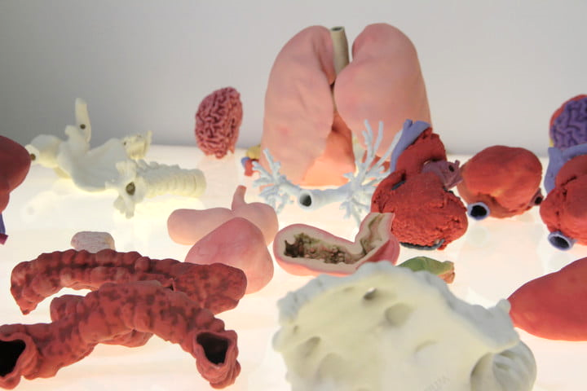
A defect organ? No worries 3D print a new one!
Wallenberg Centre for Molecular Medicine
FACULTY OF MEDICINE | LUND UNIVERSITY

Slide 3
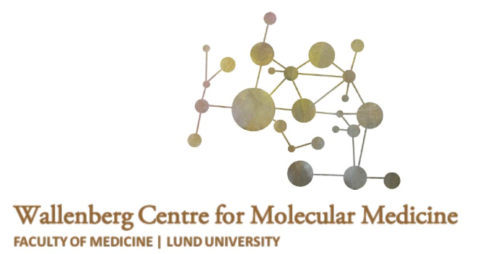
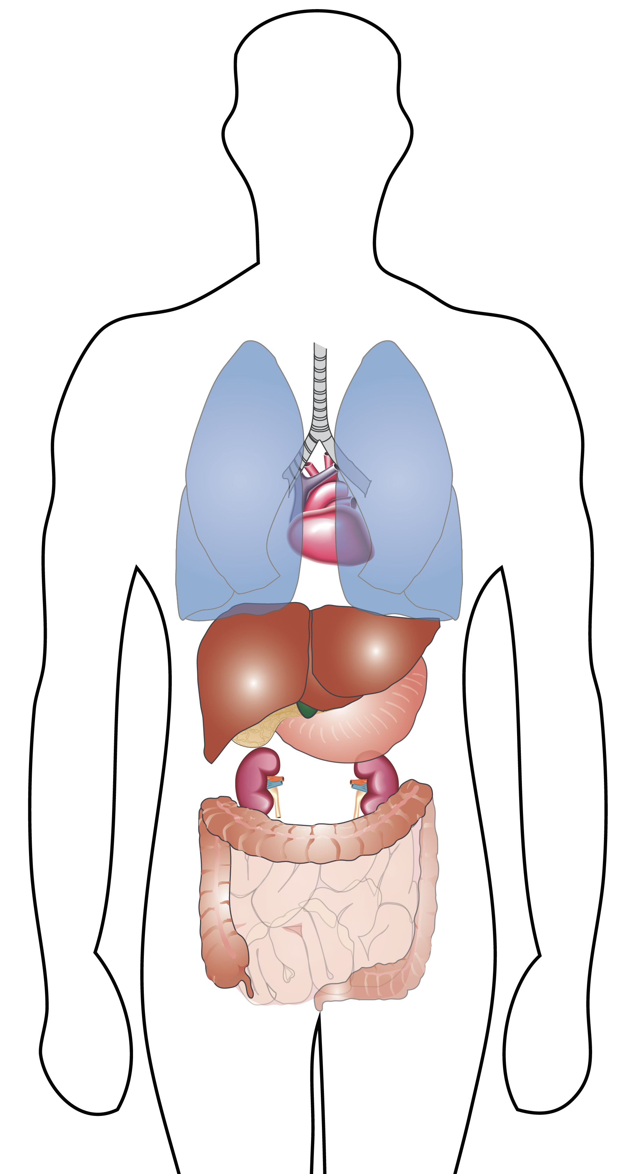
Introduction
Heart
Heart failure
Lung
Chronic lung diseases
Kidney
Diabetes
High Blood Pressure
Liver
Cirrhosis
Notes:
The diseases causing the need of organ transplantations is:
For Kidney diabetes and high blood pressure. Both diseases damages the kidney and can lead to kidney failure.
Heart: Congenital heart failure disorders from birth that will affect the heart function in adult patients. Cardiomyopathy affects the heart muscle, impairing its ability to pump blood to the rest of the body.
Lung: COPD where patients can't breathe in or out properly, and IPF where scarring occurs in the lung so the function of the lung function is reduced.
Liver: Cirrhosis is the endpoint in patients who have chronic progressive liver disease. While liver transplantation is a viable treatment option, with increasing waiting times for organ transplantation, nearly 17% of patients on the transplant waiting list in the US die annually; others are not candidates for a liver transplant.
https://transplant.surgery.ucsf.edu/conditions--procedures/cirrhosis.aspx
All these diseases can be managed with drugs to some degree, but in the end the final solution is organ transplantation.

Slide 4
Introduction
Patients on the organ waiting list January 2019, Sweden
Heart
41
Lung
20
Kidney
666
Liver
45
In 2018 there were 182 deceased organ donors in Sweden
Notes:
In Sweden , this January there were 807 people on the organ waiting list. Of those 41 patients waits for a new heart, 20 for new lungs and 666 patients are waiting for a new kidney.
Between the years 2013- 2018 the last five year period there have been between 151-188 deceased organ donors 'a year.
Each year approx. 50 patients die waiting for a new organ in Sweden.
http://merorgandonation.se/om-organdonation/organdonation-sverige/
http://merorgandonation.se/om-organdonation/statistik/add text
The trend we see in Sweden, where we can't meet the need of donor organs, is seen worldwide.
So what can we do about it?

Slide 5
Why 3D-bioprinting of organs?
In Sweden, one person on transplantation waiting lists dies each week, partly due to the lack of donor organs.
Transplantation of organs from donors offer many challenges:
Organ rejection
Organ size mis-match between donor and recipient
Many patients have to take many drugs (may have several side effects)
3D-bioprinting could increase the number of available organs and reduce the number of complications after transplantation
Notes:
Just suggestions, I know it is a lot of text!
Transition on slide
‘

Slide 6
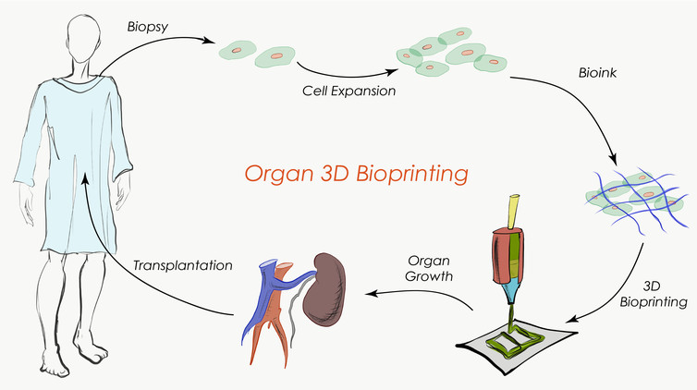
Tissue engineering paradigm
Martina De Santis, SinemTas, Deniz Bölükbas, Sujeethkumar Prithivirat, Iran Augusto De Silva

Slide 7
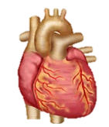
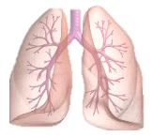
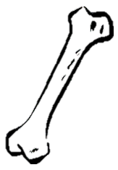
Principle of Tissue Engineering
Cells
Scaffold
Bioengineered Organ
Bioactive molecules

Slide 8
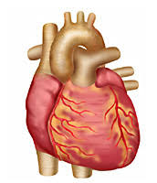
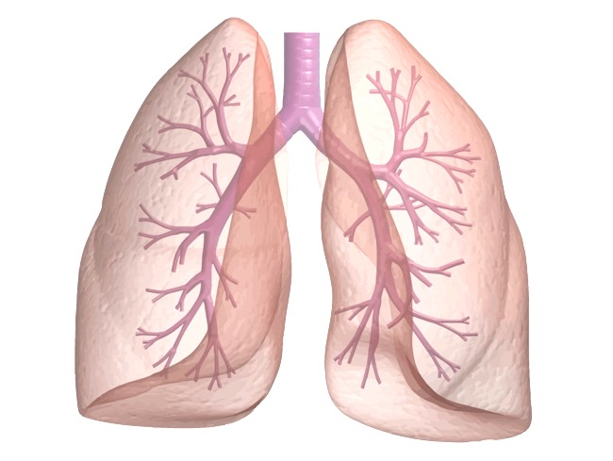
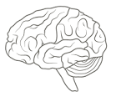
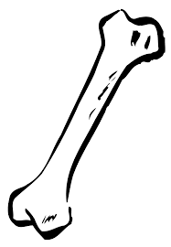
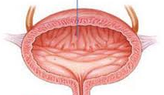
Complexity
lung
brain
heart
bone
skin
bladder
Complexity of organ
2 dimensional
Few cell types
Not moving
3 dimensional
Many different cell types
Constantly moving

Slide 9
Complexity
skin
lung
2 dimensional
Few cell types
Not moving
3 dimensional
Many different cell types
Constantly moving

Slide 10
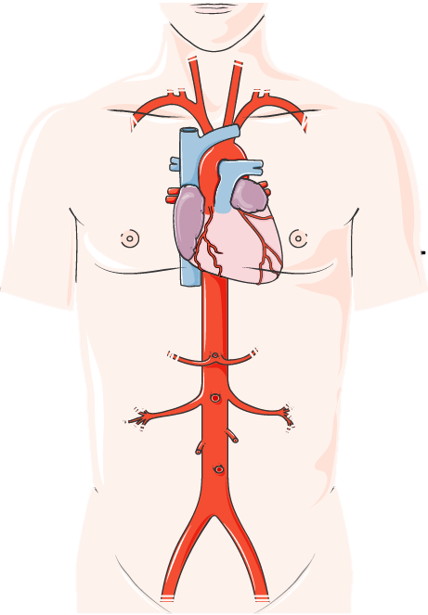
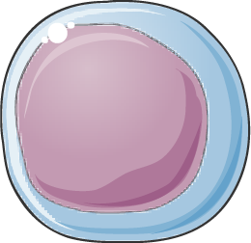
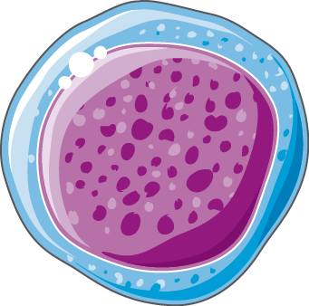
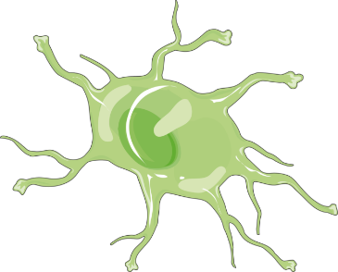
Cell source
Directly from patients’ organ
Derived from stem cells
(bone marrow, blood…)
Reprogramming to
stem cells
Fabio Rosa, Gabriela Ferreira, Cristiana Pires, Rita Alves, Olga Zimmermannova, Yang Liu, Michaela Roth
Notes:
The cells forget what they are, they don’t know that they are skin cells. By adding other types of molecules and they start behaving lin the new way.

Slide 11
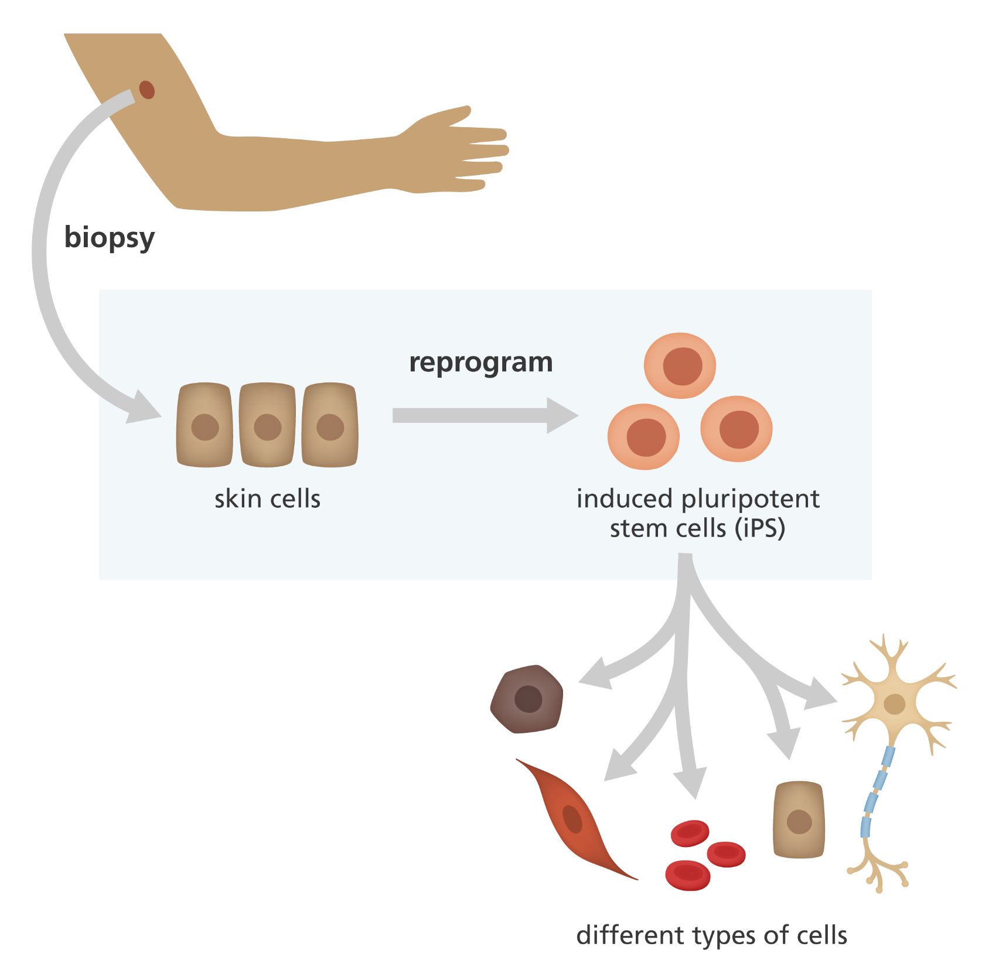
Cell reprograming
Shinya Yamanaka
Nobel price 2012
Challenge
Need to grow lots of them!
Fabio Rosa, Gabriela Ferreira, Cristiana Pires, Rita Alves, Olga Zimmermannova, Yang Liu, Michaela Roth

Slide 12
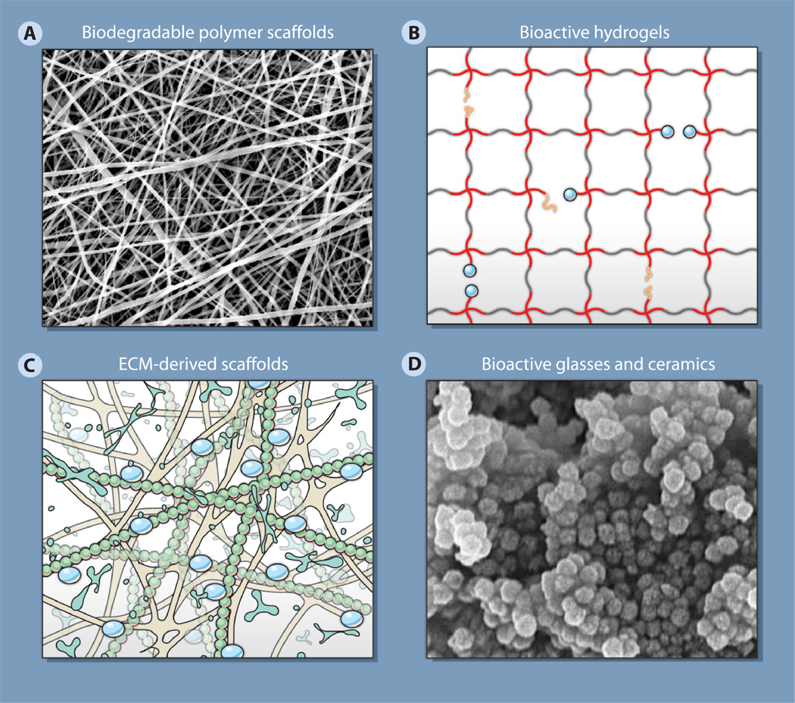
Scaffolds
Synthetic (plastic, ceramic)
Biological (collagen)
Must match:
Organ composition
Mechanical properties
Support cell growth
http://stm.sciencemag.org/content/scitransmed/4/160/160sr4/F3.large.jpg
Martina De Santis, SinemTas, Deniz Bölükbas, Sujeethkumar Prithivirat

Slide 13
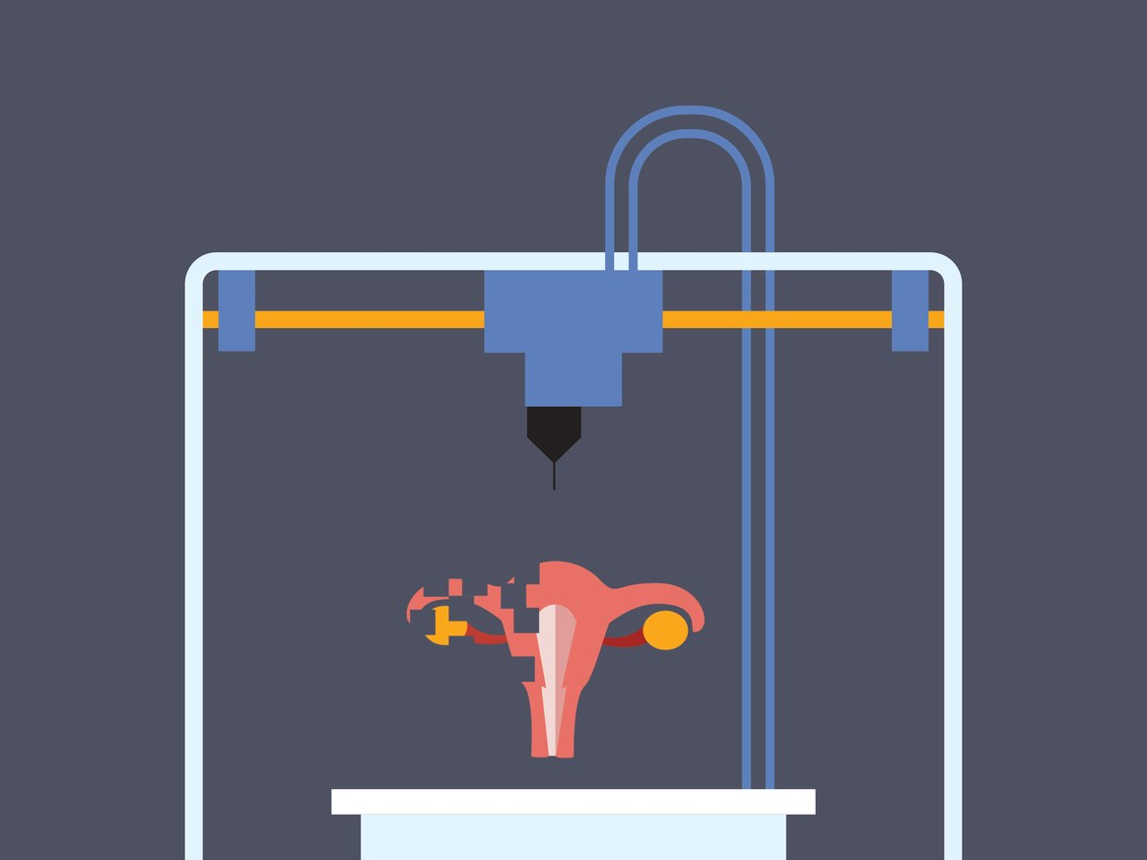
Combining cells and scaffold
Example: 3D printing

Slide 14
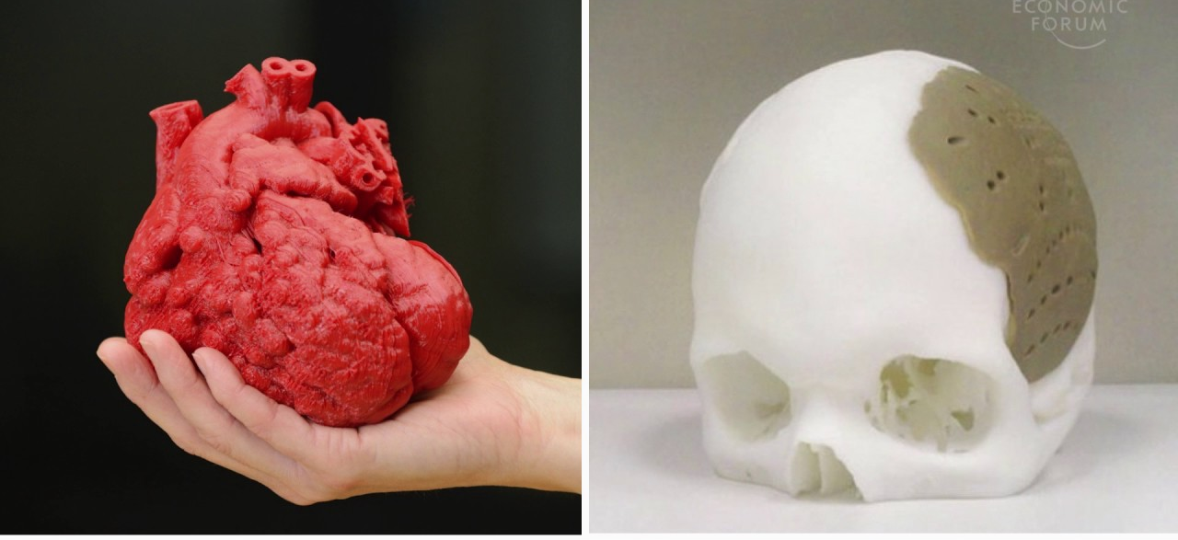
3D printing of Organs
Is it fiction or science?

Slide 15
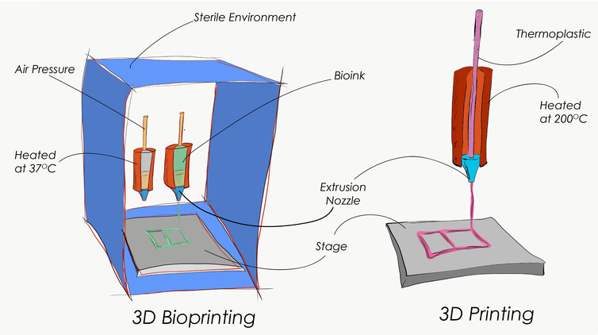
3D printing Vs. 3D Bioprinting

Slide 16
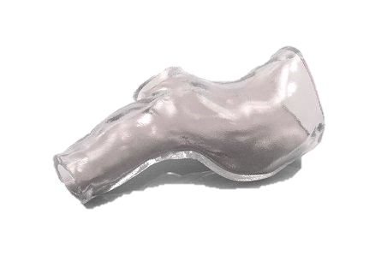
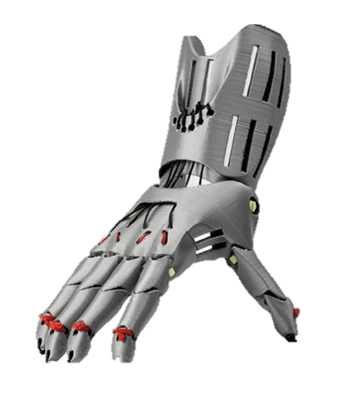
How is 3D printing used in Medicine?
Printed plastic to support a biological process
Visualization of Medical Imaging
3D bioprinting

Slide 17
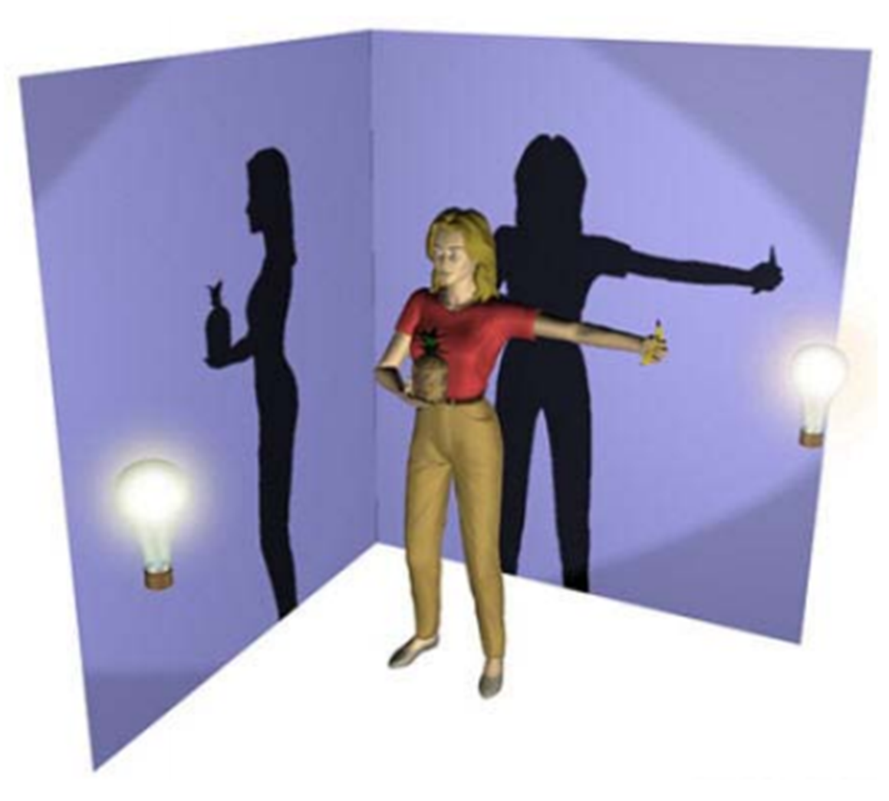
1. Printing 3D model to visualize complex structures.
2. Printed plastic that aids a biological function:
a. Printed material for structural support
b. 3D printed prosthetics
3. 3D Bioprinting of Tissue
Looking at things in 3D gives us more information.

Slide 18
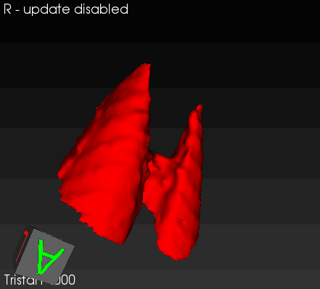
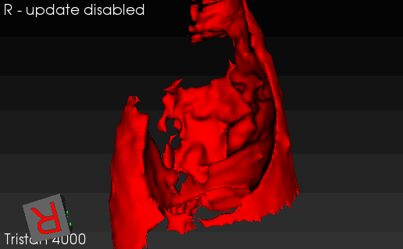
How do we obtain 3D models (Imaging)
Healthy
Diseased
MRI scans – transverse angle
Healthy
Diseased
Irma Mahmutovic Persson

Slide 19
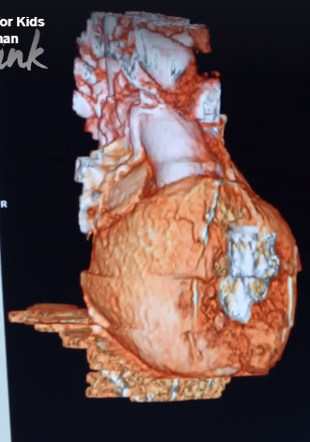
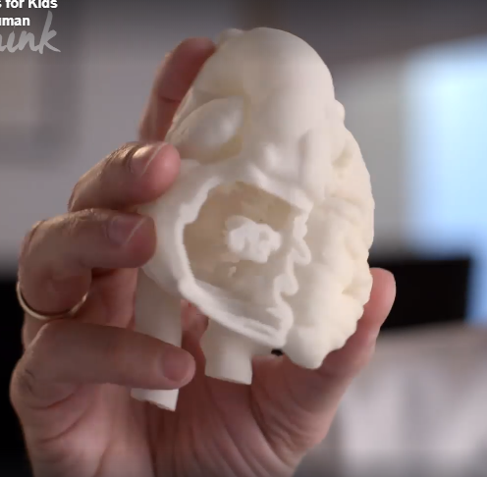
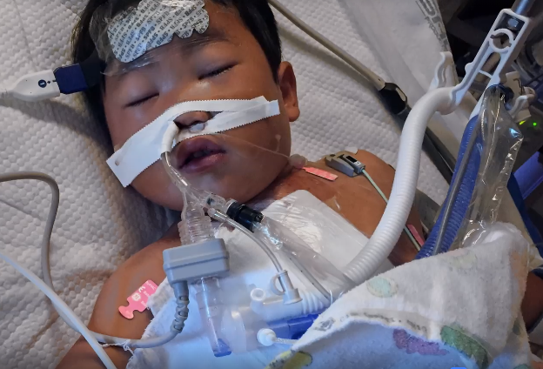
Using 3D printed models to plan complex surgeries
Franzi Uhl, Nicholas Don-Doncow, Frank Matthes, Yun Zhang

Slide 20
More complex? No problem
Victoria Ptasinski Martina De Santis, Sinem Taz, Hani Alsafadi, John Stegmayr, Deniz Bölükbas

Slide 21
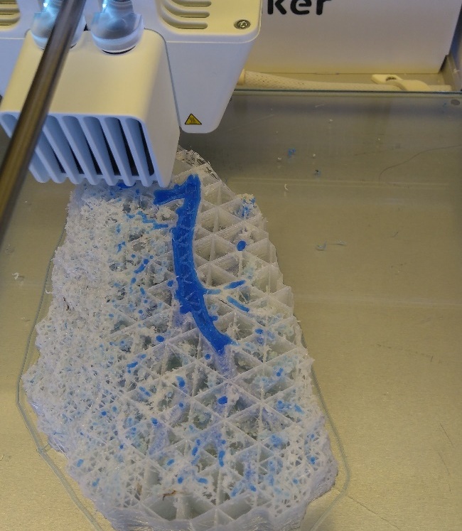
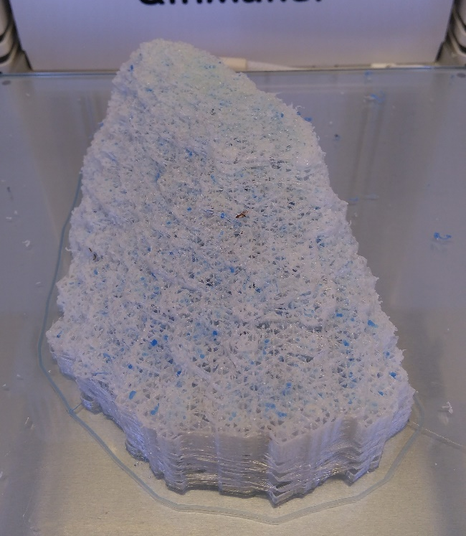
More complex? No problem
Hani Alsafadi

Slide 22
How is 3D printing used in Medicine?
2. Printed plastic that aids a biological function:
a. Printed material for structural support
b. 3D printed prosthetics

Slide 23
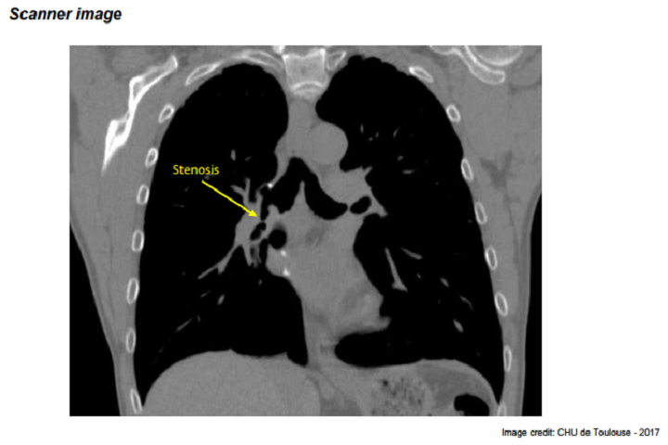
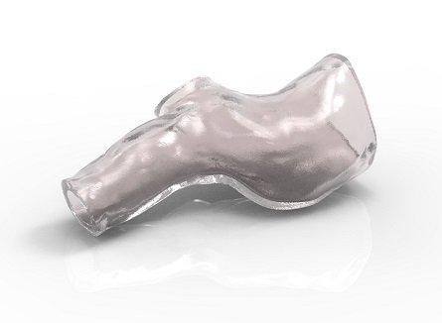
3D printed stents – clinical trial
2. Printed material for structural support
3D-print out piece
surgical
replacement

Slide 24
3D printed prosthetics
Example 1: Customized 3D printed arms

Slide 25
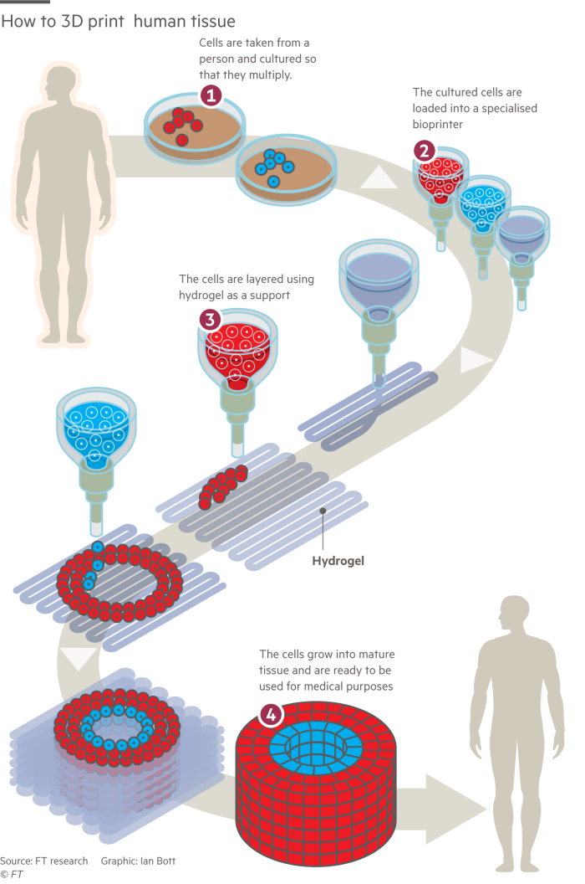
How is 3D printing used in Medicine?
3. 3D bio printing

Slide 26
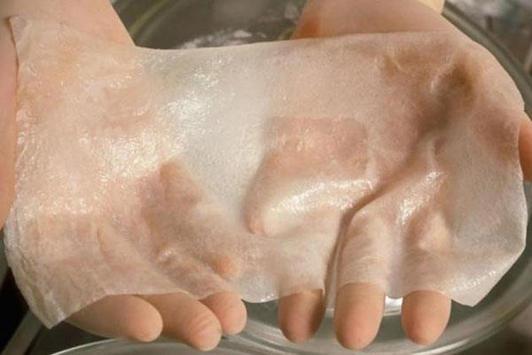
3D bioprinting – skin replacement

Slide 27
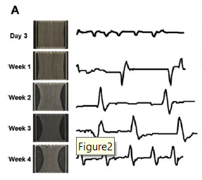
3D bioprinting –Heart?
Franziska Uhl, Nicholas Don-Doncow, Frank Matthes, Yun Zhang
Notes:
Here are the photos of the tissue printing process in different points.
The printing ended up with a piece of tissue in patch form.
The tissue also showed a spontaneous beating

Slide 28
3D bioprinting of bone
Sujeethkumar Prithivirat, Neserin Ali

Slide 29
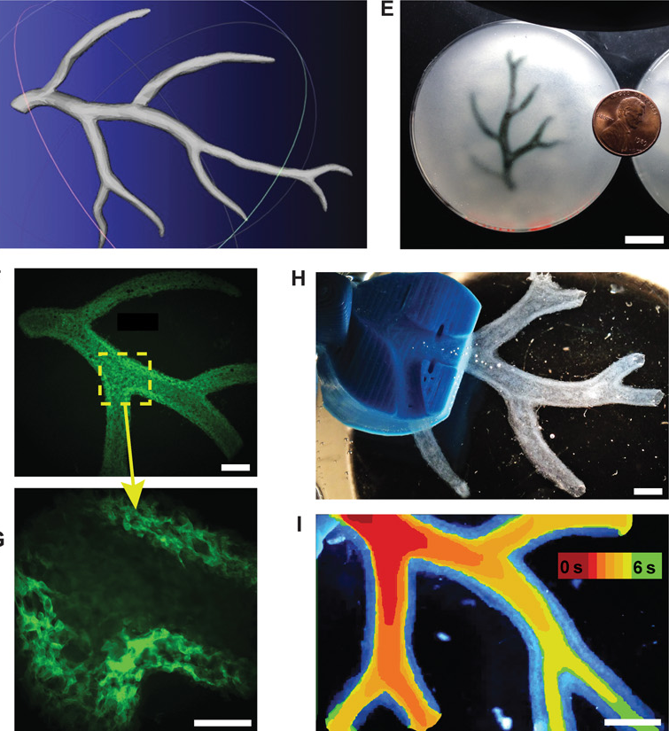
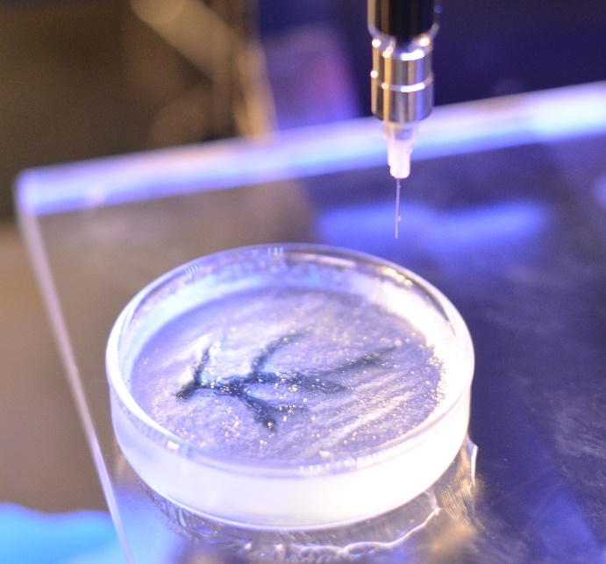
3D printing of gels
Martina De Santis, Sinem Taz, Hani Alsafadi

Slide 30
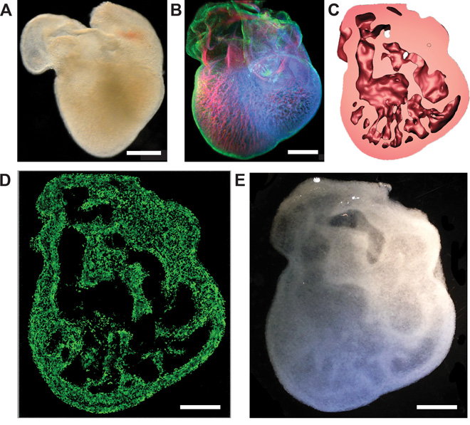
3D Bioprinting – the shape of heart

Slide 31
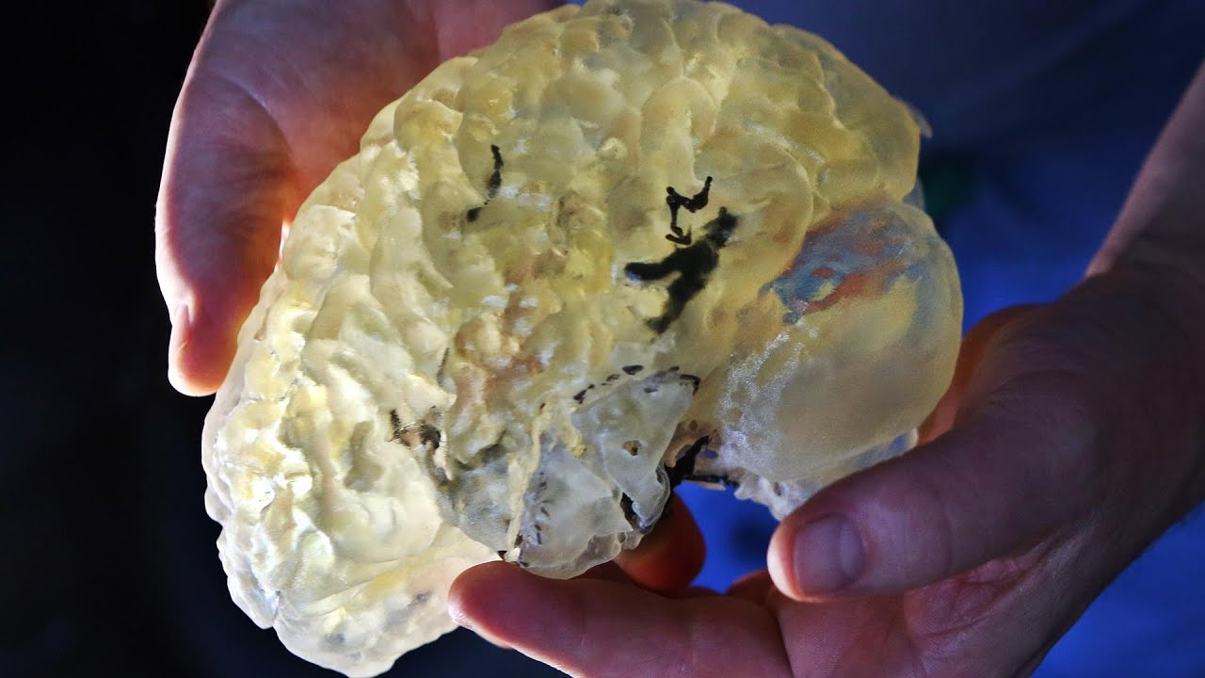
3D bioprinting - Brain?
It´s not possible to bioprint an entire functional brain!
So far only layers of neural tissue:
printed layers of bioinks
cells
molecules for cells survival
Cells can survive and be functional!
Marta Ramos, Roberta Battistella, Nicholas Bechet, Alba Garcia, Kajsa Arkelius, Alexander Lind

Slide 32
Great!!! 3D (bio)printing progressed
But how do we bring this to patients?
Lab Work
Animal Work
Clinical Trials
Usable product

Slide 33
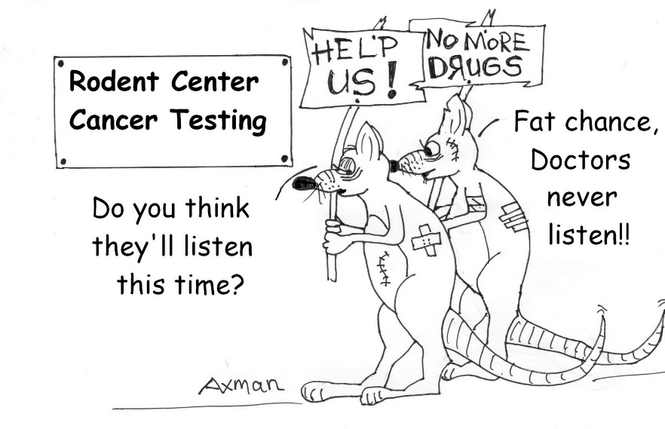
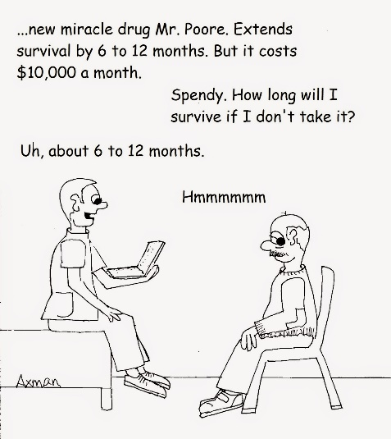
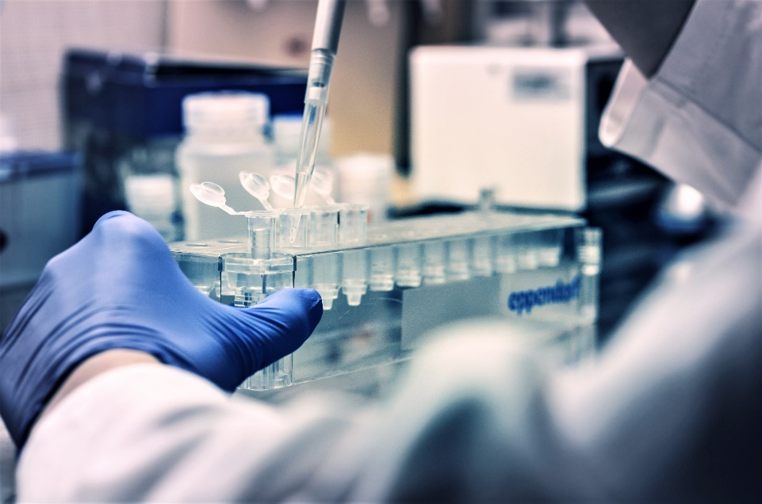
Experimental Work
Source of cells
Retrospective Patient Studies
Animal Testing
Ethical Approvals
Amednments
Clinical Trials
Usable product
Ethical Approval
Choice of patients
Allocation of the product

Slide 34
Acknowledgement
WCMM Trainees
WCMM Instructors and Clinical Fellows
Neserin Ali
Hani Alsafadi
Rita Alves
Kajsa Arkelius
Iran Augusto
Roberta Battistella
Nicholas Bechet
Deniz Bölükbas
Martina De Santis
Nicholas Don-Doncow
Alexandra Gabriela Ferreira
Alba Garcia
Alexander Lind
Yang Liu
Frank Matthes
Ingrid Yao Mattisson
Irma Mahmutovic Persson
Cristiana Pires
Sujeethkumar Prithiviraj
Victoria Ptasinski
Marta Ramos
Fábio Rosa
Michaela Roth
John Stegmayr
Sinem Tas
Franziska Uhl
Yun Zhang
Olga Zimmermannova
Anders Björkman
Paul Bourgine
Joao Duerte
Markus Hansson
Einar Heiberg
Robin Kahn
Sandra Lindstedt Ingemansson
Iben Lundgaard
Martin Magnusson
Niklas Mattsson
Anja Meissner
Gesine Paul-Visse
Filipe Pereira
Cornelis Jan Pronk
Gustav Smith
Vinay Swaminathan
Elin Trägårdh
Darcy Wagner
Anders Wittrup
Scientific Advisory Board
Dennis Burton
Olaf B. Paulson
Dirkje Postma
Robert Sackstein
Steering Group
Lars Dahlin
Hannie Lundgren
Anders Malmström
Erik Renström
Freddy Ståhlberg
Gunilla Westergren-Thorsson

